Slide 1
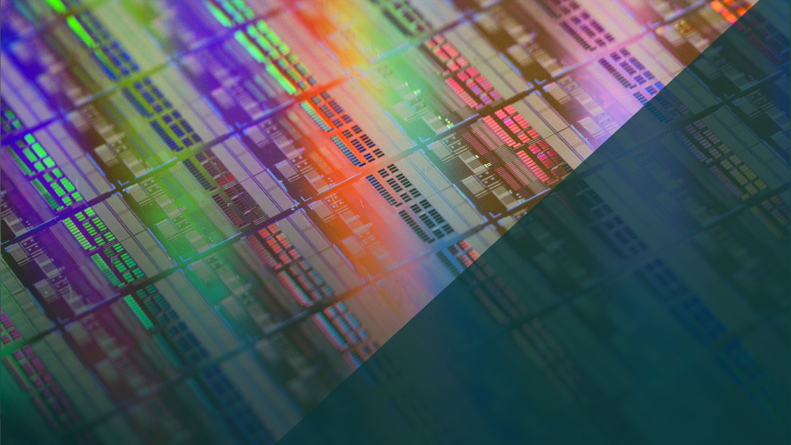
Weebit Nano Ltd
Extraordinary General Meeting
13 February 2019

Slide 2
Key updates since the AGM
Significant technical progress towards productisation
Several industry partnerships & collaborations announced
Continued positive discussions with potential partners
Discussions with several potential investors in USA and Asia
2

Slide 3
EXPECTATIONS MET
NOV 2018
Every committed technology milestone met
Initiated move to 300mm/28nm
JUN 2018
40nm 1Mbit Array
FEB 2018
40nm 4Kbit Array
NOV 2017
40nm working cells
OCT 2017
300nm 4Kbit Array
SEPT 2016
Development kicked off at Leti
3

Slide 4
Technical progress
Demonstrated industry level results on key parameters
Retention
Better than market requirements of 10 years at room temperature
Well over industry requirements at 260ºC (soldering temp, challenging for most emerging memories)
Endurance
Demonstrated conditions for above 100,000 cycles
Meets market expectation for various products (higher than most Flash memories)
Programming voltage levels are competitive with production non-volatile memories
Continuing to optimise these and other parameters as planned
4

Slide 5
Moving to manufacturing
Initial development used 40nm on 200mm wafers as a vehicle for development
Now moving towards 28nm on 300mm wafers as a vehicle for productisation
Analysis shows our current cells can fit on smaller dimension designs
Cheaper
&
Faster
Standard in the production fabs
This opens up significant markets for us
5

Slide 6
STEPS TOWARDS COMMERCIALISATION
Mid
2018
Q1
2019
Q4
2019
Q4
2020
>
2021
40nm 4Kb Array demonstrated
40nm 1Mb Array Demonstrated
Process Optimisation
28nm/300mm Integration
Production Fab Qualification
IP revenues
Done
Done
Baseline improvement to achieve robust Technology parameters
State of the art embedded process readiness
Technology transfer and IP qualification
* Timeline refers to calendar year
6

Slide 7
Partnerships building an ecosystem
Many additional partnership talks
Develop tools and models needed to integrate our ReRAM in a design
Manufacturing equipment providers
EDA vendors
Product Companies
Manufacturing companies
Multiple cooperation talks taking place
We are responding to inputs from these potential partners
We want to build the partnership on a strong foundation
7

Slide 8
Significant progress with partners
Announced Partnerships
Continuing positive progress and discussions on many additional fronts
Potential customers
Production fabs
Strategic investors
Industrial partners
…
Politecnico di Milano
Silvaco
IIT Delhi
Technion
Developing TCAD simulation models of our ReRAM
Neuromorphic Computing research
Neuromorphic Computing research
In Memory Compute research
8

Slide 9
Why share consolidation?
Reduce the number of shares on issue to a more reasonable number, to attract:
Institutional investors and family offices
Strategic investors from the industry
These investors will ensure Weebit’s capital structure adequately supports the company as it moves to production
Current share price and number of shares on issue are deterring these potential investors
Note: Consolidation does not change the value of an investors holding
9

Slide 10
consolidation lowers market cap?
A common misunderstanding
Many companies consolidate because of continued poor results which lowered the share price
These companies tend to continue to have poor results
Some “day traders” may prefer more shares on issue and may sell when there is a share consolidation
However, this enables long term, stable and supportive shareholders to enter the register
This is not the case with Weebit, which is continuing to deliver operationally
10

